Slide 1
IBM HR Analytics Employee Attrition
Group Project by:
Sonila Badjatia
Aakash Nagalapura
Jeff Wince

Slide 2
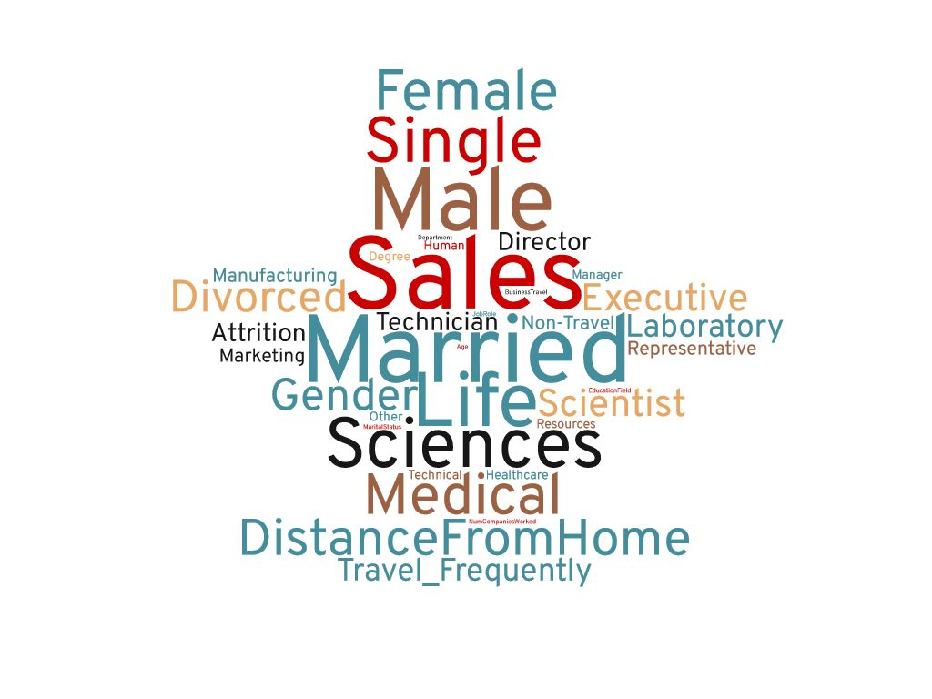

The Data (Data source: https://www.kaggle.com/pavansubhasht/ibm-hr-analytics-attrition-dataset.) IBM has gathered information on employee satisfaction, income, seniority and other demographics. It includes data for 1470 employees. The data includes employees who are still with the company and those who have left.
The question: Is there a relationship between any of the factors provided in the data and employees who left the company?
This Photo by Unknown Author is licensed under CC BY-NC-ND

Slide 3
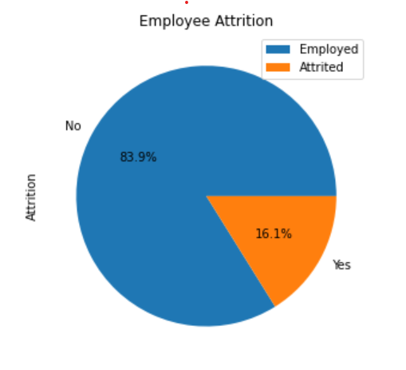
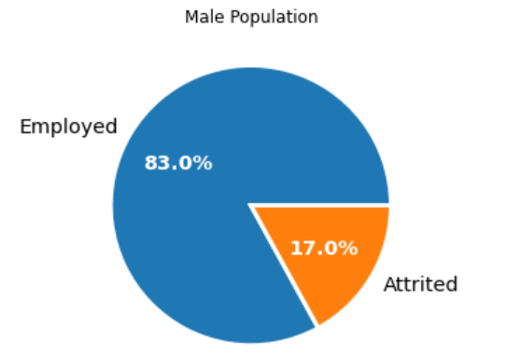
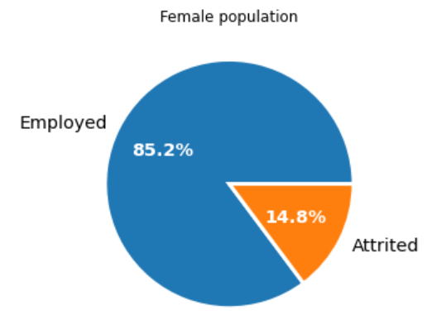
Our Methods
We looked at attrition overall and individual factors and compared them for employees who stayed with the company and those who left.
Starting point for drilling in further.

Slide 4
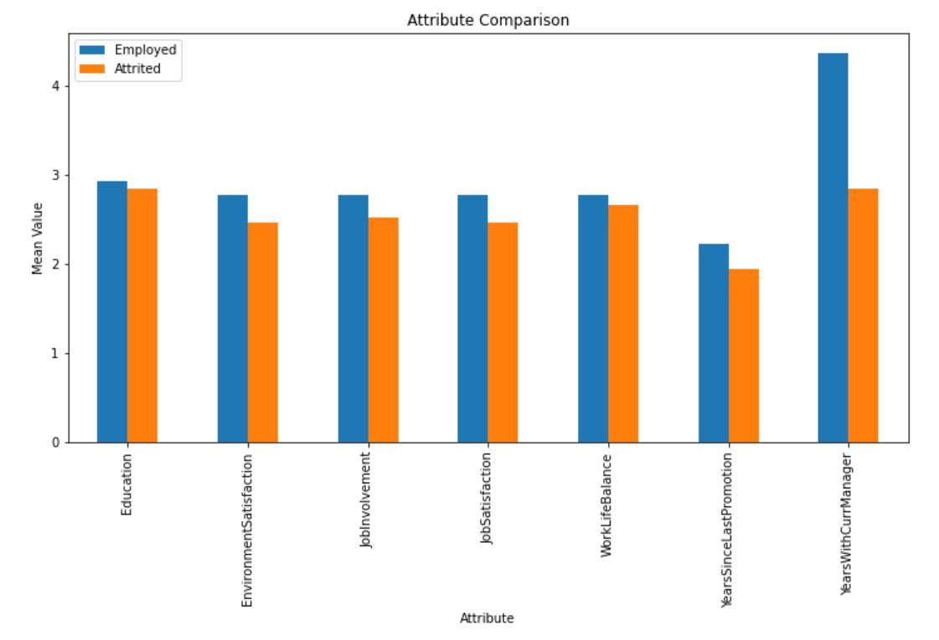
Comparison of Means
Your work is going to fill a large part of your life, and the only way to be truly satisfied is to do what you believe is great work. And the only way to do great work is to love what you do. If you haven’t found it yet, keep looking. Don’t settle. –Steve Jobs
75% of people quit their job to “get away from their manager at some point in their career. –Gallup Study 2015

Slide 5
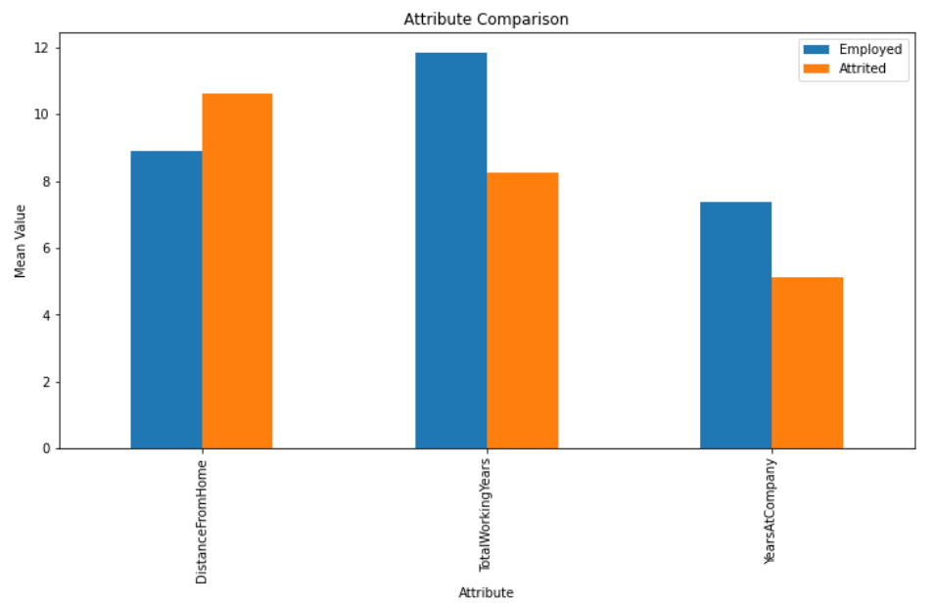
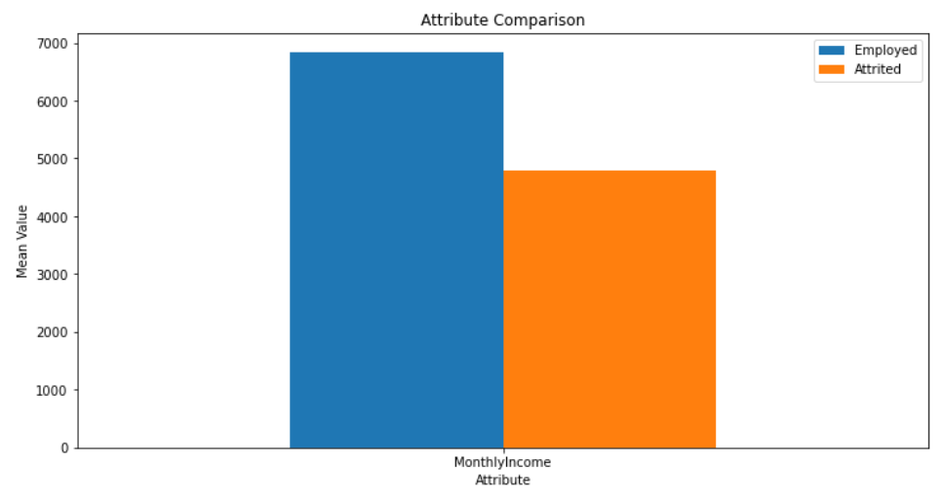
Comparison of Means (cont.)

Slide 6
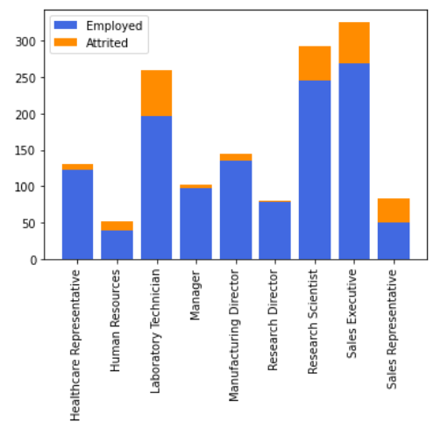
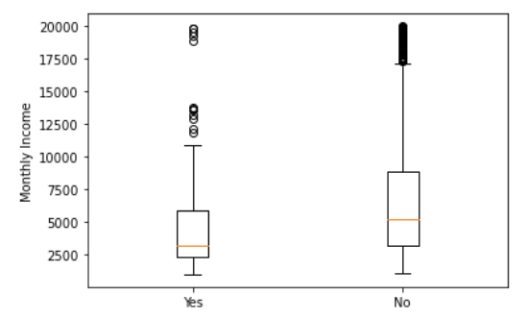
Comparison of Means (cont.)

Slide 7
Findings
There was a significant difference in the attributes around satisfaction. The following showed the largest difference between the means:
Environment Satisfaction
Job Involvement
Job Satisfaction
Time With CurrentManager-This was one of the greatest difference between the employed and attrited groups.
Monthly Income- this was also one of the greater differences
Distance From Work
Total Working Years
Years at the Company
A handful of roles account for a large portion of the attrited employees

Slide 8
Future Questions
Is there a difference between employees who leave of their own accord and those who are terminated by the company?
Do any of the factors that showed a significant difference have a relation with each other?
Future studies would be warranted if programs were put in place to make employees feel better about the stats that were lower for attrited employees.
Is there a difference in the factors between different company locations?
Is there a correlation between the lower scores and managers?

Slide 9
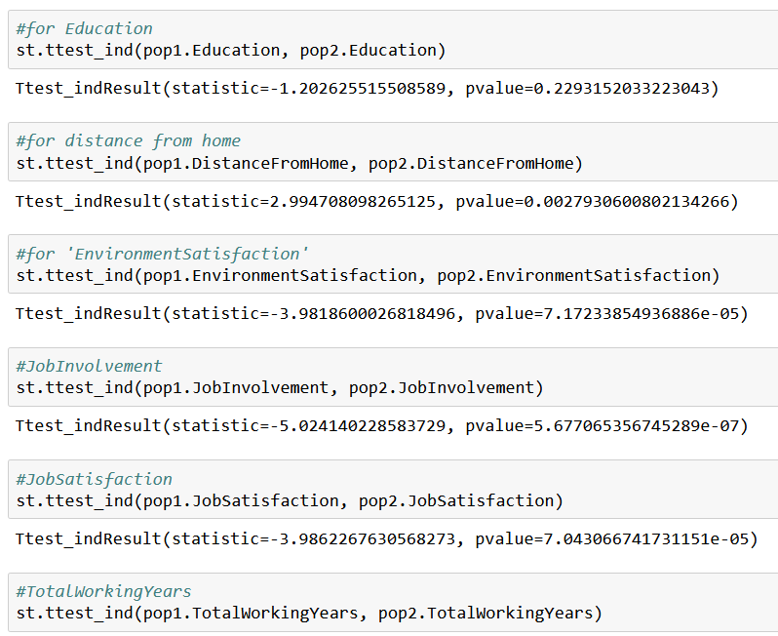
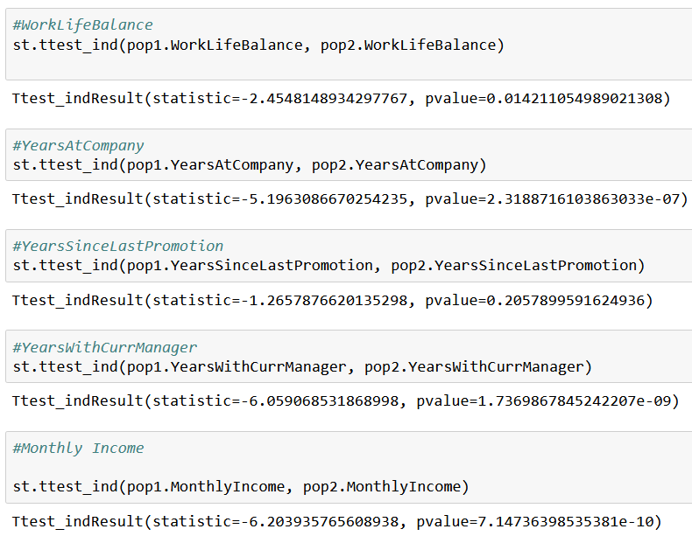
Appendices
T-test results

Slide 10
Appendices-Rating System for Employee Questions
PerformanceRating 1 'Low' 2 'Good' 3 'Excellent' 4 'Outstanding'
RelationshipSatisfaction 1 'Low' 2 'Medium' 3 'High' 4 'Very High'
WorkLifeBalance 1 'Bad' 2 'Good' 3 'Better' 4 'Best'
Education 1 'Below College' 2 'College' 3 'Bachelor' 4 'Master' 5 'Doctor'
EnvironmentSatisfaction 1 'Low' 2 'Medium' 3 'High' 4 'Very High'
JobInvolvement 1 'Low' 2 'Medium' 3 'High' 4 'Very High'
JobSatisfaction 1 'Low' 2 'Medium' 3 'High' 4 'Very High'

